Slide 1
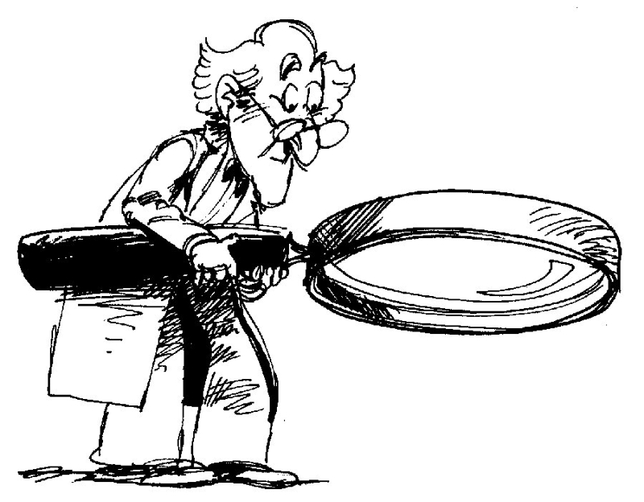
A Closer Look
Quality Goals
Appropriate Assessments

Slide 2
Student Growth Goal Sample
Checklist for Goal Quality
Appropriate needs assessment? Assesses overarching concepts of the discipline?
Specific?
Measurable?
Appropriate?
Realistic/Rigorous?
Time-bound?
Includes all students?
Comparable across classrooms?
Baseline Data:
Writing
Baseline data on an 8th grade school wide writing assessment utilizing the LDC argumentative writing rubric:
Score: 1 2 3 4
25% 45% 30% 0%
Overall, 30% of students scored a “3” or better.
Student Growth Goal:
For the 2011-2012 school year, 100% of students will make measurable progress in argumentative writing. Each student will improve by one performance level in three or more areas of the LDC writing rubric. Furthermore, 80% of students will score a “3” or better overall.
Notes:
Allow time for participants to read through the example. This sample meets all criteria.
Note in your discussion that a writing goal would be appropriate for science, social studies, and technical subjects as well - because of our shared literacy standards.

Slide 3
Student Growth Goal Sample
Checklist for Goal Quality
Appropriate needs assessment? Assesses overarching concepts of the discipline?
Baseline Data:
Writing
Baseline data on an 8th grade school wide writing assessment utilizing the LDC argumentative writing rubric:
Score: 1 2 3 _4_
25% 45% 30% 0%
Overall, 30% of students scored a “3” or better.
Student Growth Goal:
For the 2011-2012 school year, 100% of students will make measurable progress in argumentative writing. Each student will improve by one performance level in three or more areas of the LDC writing rubric. Furthermore, 80% of students will score a “3” or better overall.

Slide 4
Student Growth Goal Sample
Checklist for Goal Quality
Specific?
The goal addresses student needs within the content.
The goal is focused on a specific area of need.
Baseline Data:
Writing
Baseline data on an 8th grade school wide writing assessment utilizing the LDC argumentative writing rubric:
Score: 1 2 3 _4_
25% 45% 30% 0%
Overall, 30% of students scored a “3” or better.
Student Growth Goal:
For the 2011-2012 school year, 100% of students will make measurable progress in argumentative writing. Each student will improve by one performance level in three or more areas of the LDC writing rubric. Furthermore, 80% of students will score a “3” or better overall.

Slide 5
Student Growth Goal Sample
Checklist for Goal Quality
Measurable?
An appropriate instrument or measure is selected to assess the goal.
Baseline Data:
Writing
Baseline data on an 8th grade school wide writing assessment utilizing the LDC argumentative writing rubric:
Score: 1 2 3 _4_
25% 45% 30% 0%
Overall, 30% of students scored a “3” or better.
Student Growth Goal:
For the 2011-2012 school year, 100% of students will make measurable progress in argumentative writing. Each student will improve by one performance level in three or more areas of the LDC writing rubric. Furthermore, 80% of students will score a “3” or better overall.
Notes:
Allow time for participants to read through the example. This sample meets all criteria.
PUT DATA IN CHART

Slide 6
Student Growth Goal Sample
Checklist for Goal Quality
Appropriate?
The goal is clearly related to the role and responsibilities of the teacher.
This goal was written by an 8th grade Language Arts teacher.
Baseline Data:
Writing
Baseline data on an 8th grade school wide writing assessment utilizing the LDC argumentative writing rubric:
Score: 1 2 3 _4_
25% 45% 30% 0%
Overall, 30% of students scored a “3” or better.
Student Growth Goal:
For the 2011-2012 school year, 100% of students will make measurable progress in argumentative writing. Each student will improve by one performance level in three or more areas of the LDC writing rubric. Furthermore, 80% of students will score a “3” or better overall.
Notes:
Allow time for participants to read through the example. This sample meets all criteria.

Slide 7
Student Growth Goal Sample
Checklist for Goal Quality
Realistic/Rigorous?
The goal is doable, but rigorous and stretches the outer bounds of what is attainable.
Baseline Data:
Writing
Baseline data on an 8th grade school wide writing assessment utilizing the LDC argumentative writing rubric:
Score: 1 2 3 _4_
25% 45% 30% 0%
Overall, 30% of students scored a “3” or better.
Student Growth Goal:
For the 2011-2012 school year, 100% of students will make measurable progress in argumentative writing. Each student will improve by one performance level in three or more areas of the LDC writing rubric. Furthermore, 80% of students will score a “3” or better overall.
Notes:
Allow time for participants to read through the example. This sample meets all criteria.
PUT DATA IN CHART

Slide 8
Student Growth Goal Sample
Checklist for Goal Quality
Time-bound?
Baseline Data:
Writing
Baseline data on an 8th grade school wide writing assessment utilizing the LDC argumentative writing rubric:
Score: 1 2 3 _4_
25% 45% 30% 0%
Overall, 30% of students scored a “3” or better.
Student Growth Goal:
For the 2011-2012 school year, 100% of students will make measurable progress in argumentative writing. Each student will improve by one performance level in three or more areas of the LDC writing rubric. Furthermore, 80% of students will score a “3” or better overall.
Notes:
Allow time for participants to read through the example. This sample meets all criteria.
PUT DATA IN CHART

Slide 9
Student Growth Goal Sample
Checklist for Goal Quality
Includes all students?
Baseline Data:
Writing
Baseline data on an 8th grade school wide writing assessment utilizing the LDC argumentative writing rubric:
Score: 1 2 3 _4_
25% 45% 30% 0%
Overall, 30% of students scored a “3” or better.
Student Growth Goal:
For the 2011-2012 school year, 100% of students will make measurable progress in argumentative writing. Each student will improve by one performance level in three or more areas of the LDC writing rubric. Furthermore, 80% of students will score a “3” or better overall.
Notes:
Remember that in order for the goal to be quality it must include all students in the class.
For this to happen, pre-test data and post-test expectations must include growth goals for all students, not just a sub-population of the class.
It is important for all students to show growth.
Just as your assessment should measure over-arching skills or concepts of the discipline, so should the goal be based. We all expect our students to grow as they learn the content of the discipline, but what are the big ideas or concepts within the standards that students should master across the school year. Every discipline has these.

Slide 10
Student Growth Goal Sample
Checklist for Goal Quality
Comparable across classrooms?
Baseline Data:
Writing
Baseline data on an 8th grade school wide writing assessment utilizing the LDC argumentative writing rubric:
Score: 1 2 3 _4_
25% 45% 30% 0%
Overall, 30% of students scored a “3” or better.
Student Growth Goal:
For the 2011-2012 school year, 100% of students will make measurable progress in argumentative writing. Each student will improve by one performance level in three or more areas of the LDC writing rubric. Furthermore, 80% of students will score a “3” or better overall.

Slide 11
High School Government
Teachers in district collaborated to create a pre-assessment on Analyzing Primary and Secondary Source Documents. Students were scored on a 4 point rubric. No students scored higher than a 2 on the rubric.
Student Growth Goal:
During this school year, 100% of my students will improve in analyzing primary and secondary source documents, as measured on the district’s “Analyzing Primary and Secondary Source Documents Rubric”. Each student will increase his/her ability to analyze documents by one level on the rating rubric. Furthermore, 75% of students will score at “proficient” or above
5th grade Math
Students take a computer math assessment 3 times during the year. It assesses math standards and practices. September data showed that 70% of students scored below grade level in math.
Student Growth Goal:
For the current school year, all my 5th graders will make measurable progress in math. Each student will meet their individual goal set by the math assessment. In addition, at least 70% of my students will score on grade level.

Slide 12
Middle School Art
Baseline data show that less than 10% of students met the benchmark of a 3 or better on the art performance assessment rubric developed by the district. The rubric’s highest level is 4.
Eight students out of the 90 met the benchmark, all scoring 3.
Student Growth Goal:
By the end of the 12-week course, all students will make measurable progress. Each student will improve by at least one performance level on the district art performance rubric. 80% of students will score a 3 or better.
High School Science
On a school-developed pre-assessment of scientific practices (planning and carrying out investigations, analyzing and interpreting data, making arguments using evidence), 60% of students scored below 70%, 22% scored below 75%, and 18% scored 80% or below.
Student Growth Goal:
By the end of the 2012 school year, all students will improve their score on the school scientific practices assessment. All students will score at least 70%. Students who initially scored above 70% will improve their score by at least 10 percentage points.

Slide 13
Choosing the Right Assessments
Notes:
Reference Handout

Slide 14
Assessments for student growth goal setting must . . .
Be Rigorous –
Have high expectations for progress toward college and career readiness
Provide data toward mastery of overarching skills/concepts based on standard(s)
Notes:
Share info on slide ---- Below is information to help your talking points if needed.
From . . .
Measuring Teachers’ Contributions to Student Learning Growth for Nontested Grades and Subjects
March 2011
Laura Goe, Ph.D., ETS - Lynn Holdheide, Vanderbilt University - The National Comprehensive Center For Teacher Quality
Federal priorities (Secretary’s Priorities for Discretionary Grant Programs, 2010) specify that acceptable measures for determining teachers’ contributions to student learning must meet the following requirements:
Rigorous Rigorous measures may exhibit high expectations for student progress toward college- and career-readiness. In other words, an assessment that measures student progress in social studies would be designed to measure students’ mastery of grade-level standards for that subject. Thus, a student who does well on such an assessment should be on track to successful, on-time promotion to the next grade and ultimately to graduation.
It’s not about a unit assessment, but rather skills and concepts that students continue to develop all year and are important enough to monitor across the year.
Having the right assessment is key in identifying what skills and concepts students need to develop across the year.

Slide 15
Assessments for Student Growth Goal Setting Must . . .
Provide data between two points in time (pre-/post-assessment)
Provide baseline data
Provide post data by end of goal-setting period
Be comparable across classrooms within or across districts
Notes:
Share information on slide – below is information for talking points if needed.
From . . .
Measuring Teachers’ Contributions to Student Learning Growth for Nontested Grades and Subjects
March 2011
Laura Goe, Ph.D., ETS - Lynn Holdheide, Vanderbilt University - The National Comprehensive Center For Teacher Quality
Federal priorities (Secretary’s Priorities for Discretionary Grant Programs, 2010) specify that acceptable measures for determining teachers’ contributions to student learning must meet the following requirements:
Between two points in time Between two points in time may mean assessments that occur as close as possible to the beginning and end of a course so that the maximum growth toward subject/grade standards can be shown.
Comparable across classrooms Comparable across classrooms has two possible interpretations, both of which are useful to consider:
¡¡The measures used to show students’ growth for a particular subject are the same or very similar across classrooms within a district or state.
¡¡The measures used in nontested subjects and grades are as rigorous as those in tested subjects and grades. In other words, measures used to document student learning growth in art, music, and social studies must be as rigorous as those for student learning growth in reading/language arts and mathematics.

Slide 16
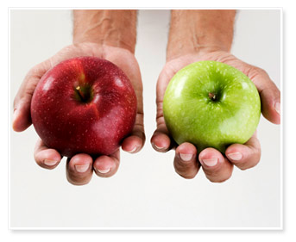
Comparable across classrooms
The measures used to show student growth for a particular subject are comparable across similar classrooms within or across districts.
The measures used in state non-tested subjects and grades are as rigorous as those in tested subjects and grades.
Notes:
So, what does comparable across classrooms mean?
Similar classrooms should be measured with similar instruments to ensure that all students are treated fairly. The rigor of the goals should also be comparable across similar classrooms.
This is referring to similar classrooms within a school, a district, or better yet, the state or nation.
This is also reflected in the work of Dr. Laura Goe, when writing for The National Comprehensive Center For Teacher Quality, who insists that “comparable must include the assurance that state tested and non-tested grades generate goals of equal rigor.”

Slide 17
So, what assessments are being used in your district that meet this criteria?
Notes:
(transition slide)
Let’s take a few minutes to think about the assessments being used in your district that meet this criteria.
Share next two slides before providing time for participants to share ideas.

Slide 18
Data Source Possibilities
Interim Assessments
Common Assessments
Projects
District Assessments
Products
Student Performances
Student
Portfolios
LDC/MDC Classroom Assessments
Notes:
Notice there are several data possibilities. Assessments must provide baseline information for mastery toward skills/concepts within the standards and/or 21st century skills. This is your pre-assessment step.
You may have district assessments for your content area or have developed common assessments in your school or district to assess students. Assessments may also include student projects , performances, products and portfolios.
Many schools use interim assessments. What kinds are used in your school or district? (some possibilities are MAP, ThinkLink/Discovery Ed, DIBELS)
Also, many of you may be involved in Literacy Design Collaborative and developing modules. The Classroom Assessment option in the LDC model can be used to provide baseline data as well. Those involved with Math Design collaborative who are implementing formative assessment lessons may design assessments appropriate for measuring student growth over time as well.

Slide 19
Data Source Possibilities
Comparable across Classrooms
Interim Assessments
Common Assessments
Aligned to Standards
Projects
District Assessments
Products
Descriptive Rubrics
Overarching
Skills & Concepts
Student Performances
Student
Portfolios
Classroom Assessments
Notes:
Whatever assessment you use, note that assessments need to be standards-based but provide information on the overarching skills or concepts of the discipline.
Descriptive rubrics would need to accompany assessment data and also need to be aligned with standards
Assessments should also be comparable across classrooms as this supports validity.

Slide 20
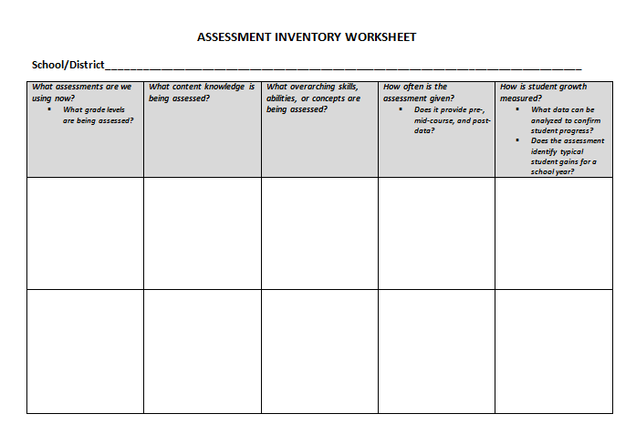
Assessment Inventory Worksheet: Which assessments might your teachers use for goal-setting?
Notes:
Refer back to the Assessment Inventory Worksheet . Districts should use this for continuing the discussion within their districts.

Slide 21
Next Steps for Comprehensive Assessment Implementation
Continue the discussion in
your district.
Notes:
Refer to handout

