Slide 1
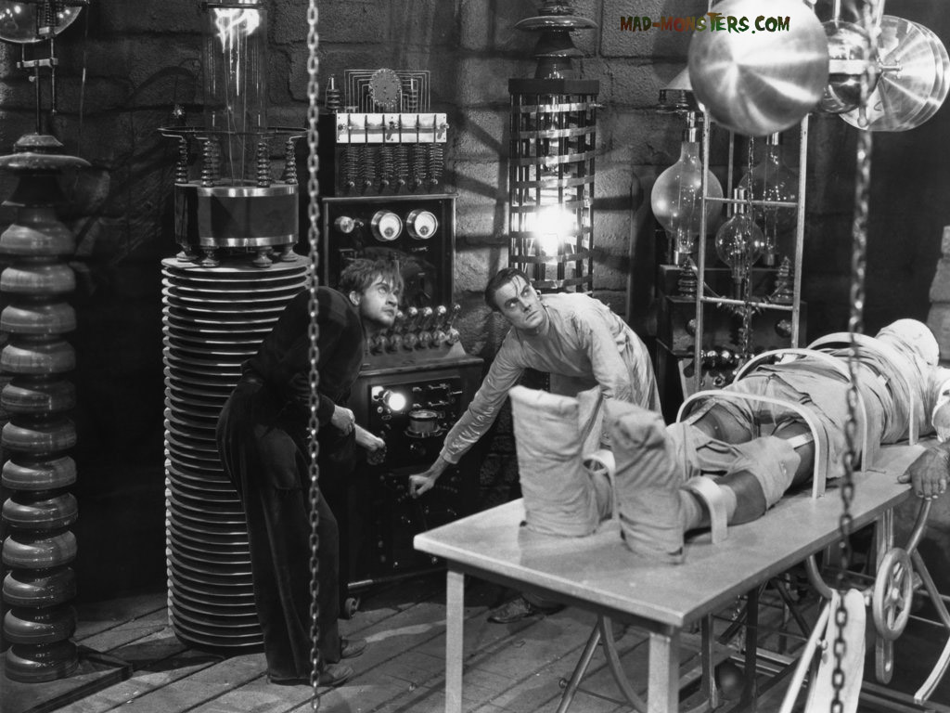
Recognizing and Supporting Rigor in the Classroom
Notes:
The body is set up into rigormoris the table is supporting him.

Slide 2
What is Rigor?
Chocolate
A preparation of the seeds of cacao, roasted, husked, and ground, often sweetened and flavored, as with vanilla.
Rigor
Strictness, severity, or harshness, as in dealing with people
Notes:
So what is rigor
What is chocolate? Do you know the dictionary definition of chocolate? Do you really know what it is? Right now can you smell it? Taste it?
Did you think of your favorite chocolate bar?
Look at the definitions. Did knowing the definitions help?
So, to know what Rigor is you have to experience it. Just like you have to taste chocolate. I can give you the definition

Slide 3
Experience – Ask yourself
What did it look, feel, sound like?
What was I doing?
What did others do (if anything) to create that experience for me?
Notes:
Think back to a personal experience where you experience a learning experience that your believe was rigorous. Ask yourself these questions.

Slide 4

Have you ever had this conversation?
Notes:
Picture links to video Non example of how we talk about “rigor”

Slide 5
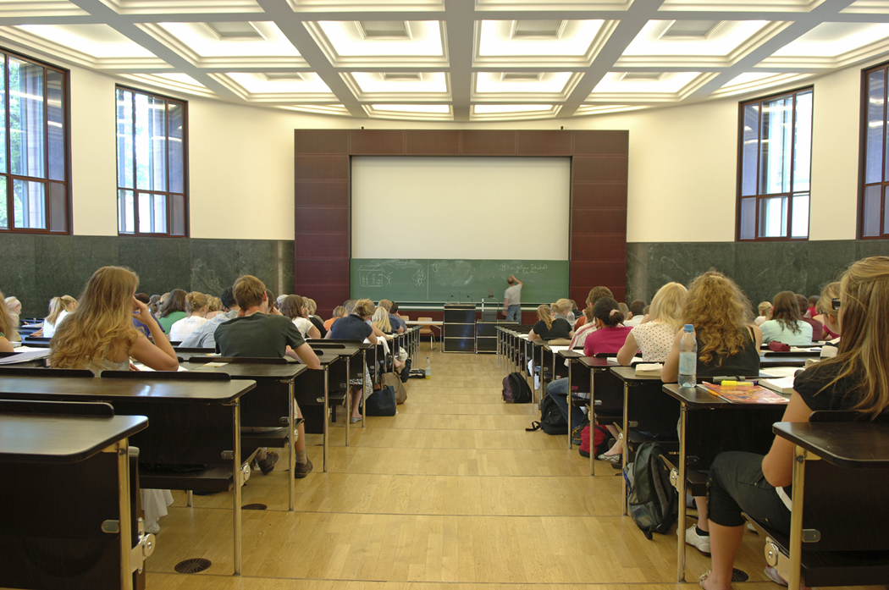
A visit to a mathematics classroom:
What (and whom) do you hear when you go into the mathematics classrooms in your building or district?
What do you see when you go into the mathematics classrooms in your building or district?
Notes:
Have teachers answer questions individually on index cards. Pair share, then discuss whole class.

Slide 6

A Common Definition Of “Rigor”
Rigor is not
Rigor is
Harder
Failing students
More work
Student responsibility (their fault if they don’t get it, they should work harder!)
Cognitively demanding
Opportunities for deeper connections
Application of skills, processes
Student responsibility (they have understanding of where they are in relation to target and know how to get help to get there)

Slide 7

What Research Says About Rigor (TIMMS Video Study, 1993)
Most of time in US math classes is spent practicing mathematical procedures and reteaching
The key feature of success is that students engage in active struggle with mathematics concepts and procedures.
Notes:
Introduce Teaching Gap Article (In folder)

Slide 8
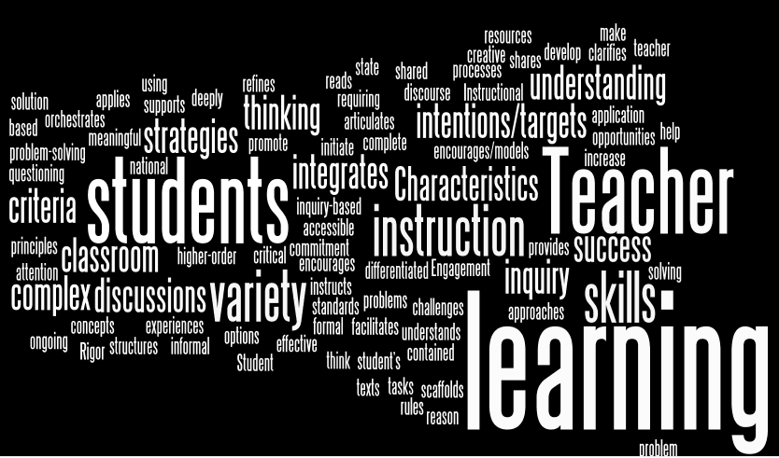
CHETL Section 3

Slide 9

Framework for Teaching
Domain 1 – Planning and Preparation
  1C Setting Instructional Outcomes

Slide 10
Questions to ask about the classroom:
They require students to apply what they know about mathematics
Moving around the classroom asking questions and taking notes about the conversations, strategies, etc. s/he observes.
Usually with another question such as, “What have you already tried?” “What do you already know that can help you?” “Does it matter that …?”
Who is doing most of the talking?
Who is working the problems?
What kinds of questions are being asked?
What are the problems like?
What happens when a student gets stuck?
Where is the teacher during practice?
How does s/he answer students when they ask a question?
It depends!
Always the students!!!
Higher order questions that require higher level cognitive engagement.
They talk with a partner to try to figure it out. The teacher may ask a question to help them figure out what they already know that can help them. They try out different ideas.
Notes:
Graphic organizer for this to have them put down notes is in folder (Questions to ask about the classroom).
Change It depends to students AND teacher

Slide 11
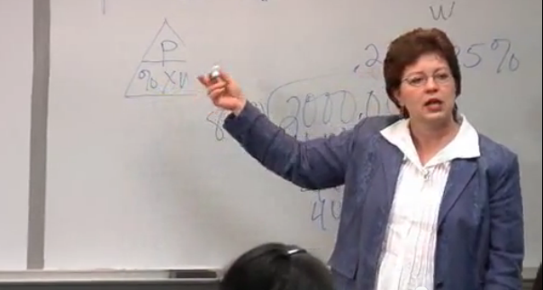
Let’s Observe!
Notes:
Watch section of video from 32.12-34.27. Discuss using questions. (You will have to manually find the part, b/c I’m too stupid to clip it!) Picture is link.

Slide 12
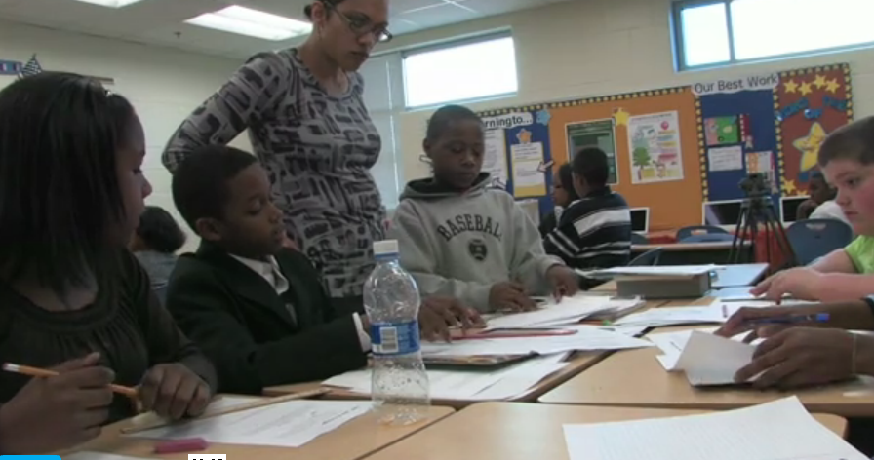
Let’s observe another class.
Notes:
Watch video and discuss using questions. (picture is link)

Slide 13

Who is doing
the thinking?
My brain hurts!
Notes:
This is the simplest definition of rigor and essentially what one should look for in the classroom.

Slide 14
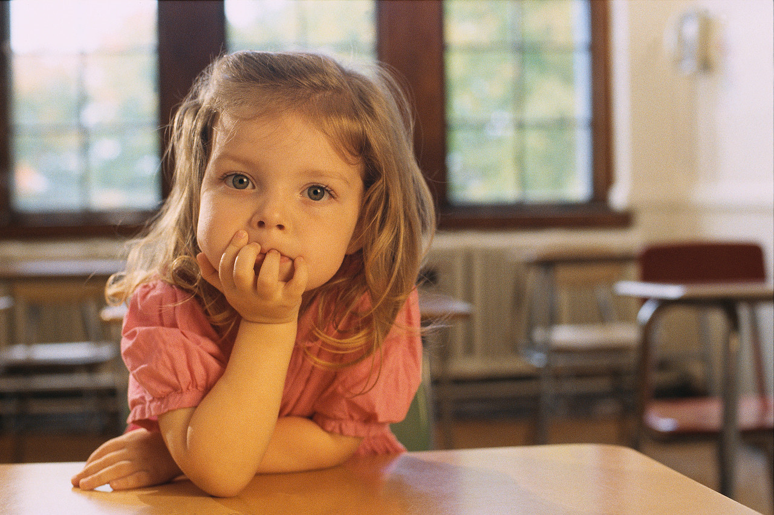
Write a new scenario!
Notes:
This is your baby/grandbaby! Jot down on an index card three things you would like to see in the mathematics classroom she attends. Pair/share, group share, report.

Slide 15
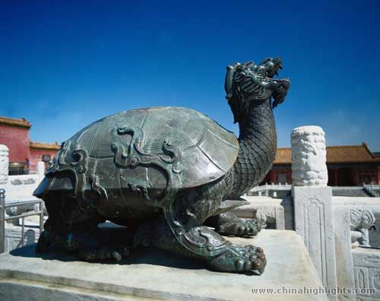
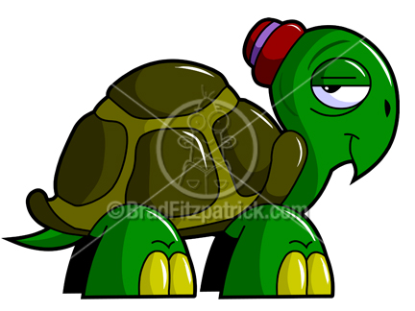
Tortoise
Teacher
Slow
Tired
Silly
Tough
Divine
Sacred
Wise
Long-lived
Notes:
Spend a few minutes having them list their ideas about a turtle. Then show them how a turtle is portrayed in different cultures.
This is part of what causes the inertia that occurs in the teaching profession. Compared to our idea of what a good teacher is from our experiences and our culture, we are good teachers. We don’t look at a teacher from the learning perspective b/c that is not our culture. Teachers teach, students learn. Think about a child playing teacher. What do they do? How do they act? Think about how teachers are portrayed on tv.
This also applies to administrators. Did your friends who were teachers think of you differently when you became a coach or administrator?

Slide 16


Teacher
Notes:
How do we switch the conception of teacher from this (picture on right) sage on the stage, definer and giver of knowledge, center of classroom. To (picture on left) facilitator of learning, asker of questions, part of the learning.

Slide 17
How do you support the change?
Shift focus to student actions/responses.
Isolation must be removed. Direct, in-classroom support works best for initiating, honing, and adapting new instructional strategies.
Training must be done with teachers rather than to teachers, and this takes a team.

Slide 18

Change Paradigms
Everybody on the bus!
A few key people in the car!
Notes:
Have to change the bus paradigm.
Teachers cannot be viewed as riders on the bus.
Leader can not be viewed as getting everyone on the bus
Leader doesn’t necessarily do the driving, because leadership for change does not reside with one individual.
(All of this is from the same book. If you now have it, I will send you the pages I got it from.)

Slide 19
The Leader’s Job
Who gets in the car?
In what order?
To what destination?
Good news: Others can drive as well, but the leader has to know the destination and provide clear directions.

Slide 20
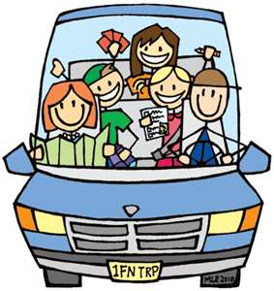
So, who gets in the car first?
Initiators (3-10%)
Earlier Adopters (15%)
Later Adopters (60-82%)
Resisters (15%)
Notes:
Initiators have already jumped in a vehicle and are moving toward the destination. They aren’t waiting for the leader, but the leader needs to monitor that they don’t miss the intended destination. Also, teachers who aren’t initiators don’t follow them!
Earlier adopters are your formal and informal teacher leaders. They need to be driven to the destination first. They will wait for leadership to drive them there. If they don’t get in the car and go to the destination, later adopters will not even get in the car! Resisters we’ll talk about later.

Slide 21
Teachers working together with their leader not only have support to change but also gain a high level of commitment to execute change.
Collegiality is a professional interaction among teachers and leaders with the purpose of learning from each other to develop expertise together.
Collegiality is a break from the isolation of teachers working and learning on their own.
Notes:
So you have them in the car.
Read scenario 2 (also from the book) for an example of this: what is happening in the car.
Discuss how this is similar to and different from things we have done in past or are doing now.
Green – teachers working with the leaders. Principals and leaders should be learning together. Purple and pink - the learn from each other and have that shared learning experience to draw on later in PLC’s

Slide 22

What’s happening in the car?
Planning lessons/assessments collaboratively.
Watching and discussing each others’ classroom lessons.
Learning about the content standards and standards for practice together.
Planning and trying out strategies, questions, etc. and discussing the results.
Developing, using, and refining instruments to assess their own teaching and their students’ learning.
Analyzing data. (not just state assessment data!)

Slide 23
What does this mean for you?
You must be in classrooms. You can’t lead classroom change if you never see, know, or take part in what is going on there!
You need a leadership team.
Team means learning together and shared leadership.

Slide 24
AND…
Focus on student action and learning that results from teacher action.

Slide 25


Where is everybody?
Initiators
Early Adopters
Late Adopters
Resisters
Notes:
The initiators are off on a new idea already. However, nobody follows them because everyone knows they are off on a new idea!
The Early adopters are moving ahead and becoming experts at the changes they are implementing.
The Late adopters are learning from the early adopters and getting better at implementation.
The resistors are going nowhere! So, what are we doing about them?

Slide 26
What do we do with the resistors?

Slide 27
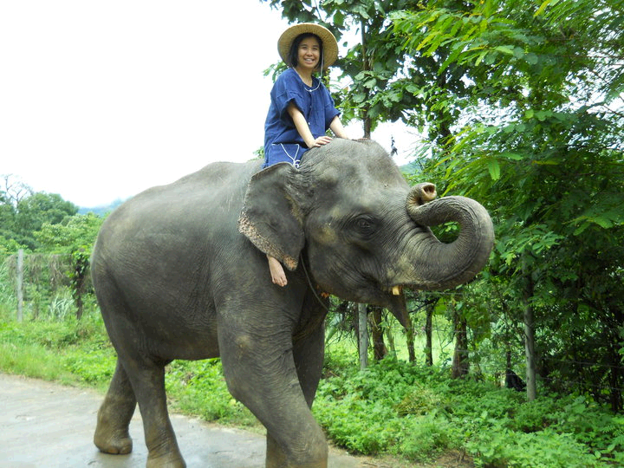
Another Metaphor
Rational
Path
Emotional
Notes:
This is from Switch and also from JoEllen. In order to move resistors (or anybody) forward, you have to appeal to the rational side, which is the rider (eg why will this work, what is the research, what is the anecdotal evidence?) to the emotional side, which is the elephant (what’s in it for me, how will it make my life better, how will it improve things for my students), and you must smooth the path (take obstacles out of the way, make sure your directions are clear.)

Slide 28
The Rider
Weaknesses
Strengths
Can easily be overpowered by the elephant
Tends to overanalyze or overthink things
Ability to think long-term
Ability to plan
Ability to think beyond the moment
The Elephant
Weaknesses
Strengths
Lazy and skittish
Looking for a quick payoff
Fierce emotion/dedication
Energy to get things done
Notes:
Knowing the strengths and weaknesses of both the rider and the elephant can help you determine how best to approach a situation.

Slide 29

So, if you want to change behavior:
Direct the rider. What looks like resistance is often a lack of clarity. So provide crystal clear directions.
Motivate the Elephant. What looks like laziness is often exhaustion. The rider can’t get his way by force for very long. Engage people’s emotional side.
Shape the Path. What looks like a
people problem is often a situation
problem.
Notes:
Look at scenario 1 Basic Skills. (again, from the same book)
Can you pick out where Mr. Hyatt directed the rider? Where he motivated the elephant? Where he shaped the path?

Slide 30
Many educators work within the framework of what is expected. It is safe and it is what people are used to doing. Unfortunately, this is not where needed change in education will come from. A new conception of teaching and learning cannot be developed within this framework. The teaching gap will persist. The bridge to improving teaching methods will crack.
Closing the Teaching Gap Donald B. Bartalo, 2012
Notes:
So, if we truly want to affect positive change in education, we have to shift paradigms. We can’t operate with our conception of the teacher as imparter of knowledge. We have to help teachers to understand that rigor is letting students do the thinking, allowing them to make mistakes and learn from them. The job of administrators is to help teachers to make this shift and to support them as they learn the finer points of creating and maintaining a truly rigorous classroom.

Slide 31
Contact Us
Teresa Emmert, NBCT
  Kentucky Department of Education
  Teresa.emmert@education.ky.gov
  www.Teresaemmert.weebly.com
Renee’ Yates, NBCT
  Kentucky Department of Education
  Renee.yates2@education.ky.gov
  www.reneeyates2math.com

