Slide 1
1. How much will it cost to fill the tank? 2. Write down a guess. 3. Write down an answer you know is too high and one that is too low.

Slide 2
What Information Would Be Useful to Know?
How many gallons of gas is being purchased?
IMAGE of Total Gallons
Cost of gas
How can we use the video and pictures to help us answer this?
IMAGE before fueling
IMAGE after 5 Gallons
IMAGE after 10 Gallons
IMAGE after 15 Gallons

Slide 3
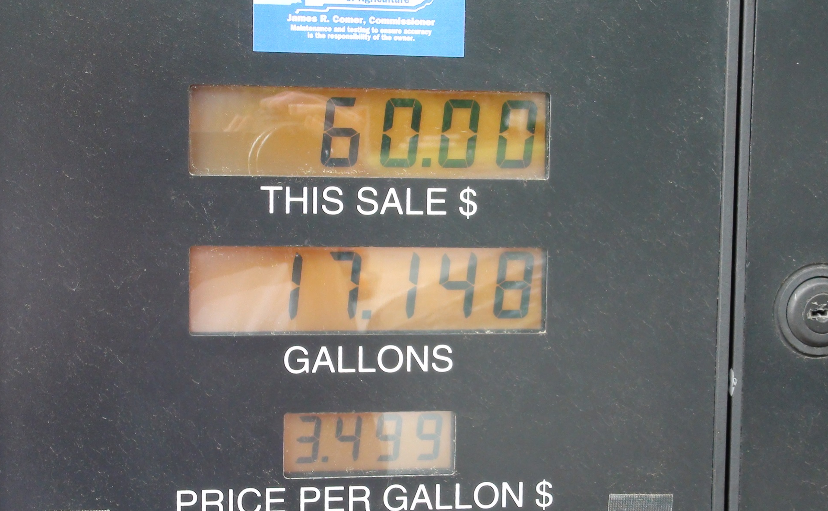
The Gas Tank Fills Up
Total Cost: $60.00

Slide 4
Gallons of Gas Purchased
Click on Return button to go back

Slide 5
Before Fueling
Click on Return button to go back

Slide 6
After 5 Gallons
Click on Return button to go back

Slide 7
After 10 Gallons
Click on Return button to go back

Slide 8
After 15 Gallons
Click on Return button to go back

